Slide 1

Practical 2
Evaluation of Expressions Using Stack

Slide 2

Lesson Plan
Subject/Course | Competitive Coding
Lesson Title | Evaluation of Expressions Using Stack
Lesson Objectives
Learn how operators and operands are handled using LIFO principle.
Implement a program to evaluate a postfix expression using a stack.
Understand how this concept applies in compilers and calculators.

Slide 3
Problem Statement:
Write a program to deal with real-world situations where Stack data structure is widely used Evaluation of expression: Stacks are used to evaluate expressions, especially in languages that use postfix or prefix notation. Operators and operands are pushed onto the stack, and operations are performed based on the LIFO principle.
Objective : To understand how the Stack data structure is used in evaluating mathematical expressions like postfix (Reverse Polish Notation) or prefix forms.

Slide 4
Concept
Expressions can be written in three common notations:
Infix: (A + B) * C
Prefix: * + A B C
Postfix: A B + C *
In postfix (RPN), operators come after operands.
✅ No need for parentheses
✅ Easy to evaluate using stacks
Why Stack?
Because operations are performed in reverse order of insertion — ideal for LIFO behavior.

Slide 5
Steps to Evaluate a Postfix Expression:
Initialize an empty stack.
Scan the expression from left to right.
If operand: Push it onto the stack.
If operator:
Pop two operands from the stack.
Perform the operation.
Push the result back onto the stack.
After scanning the entire expression,
the final result will be on the top of the stack.
Example:
Expression → 5 6 2 + * 12 4 / -

Slide 6
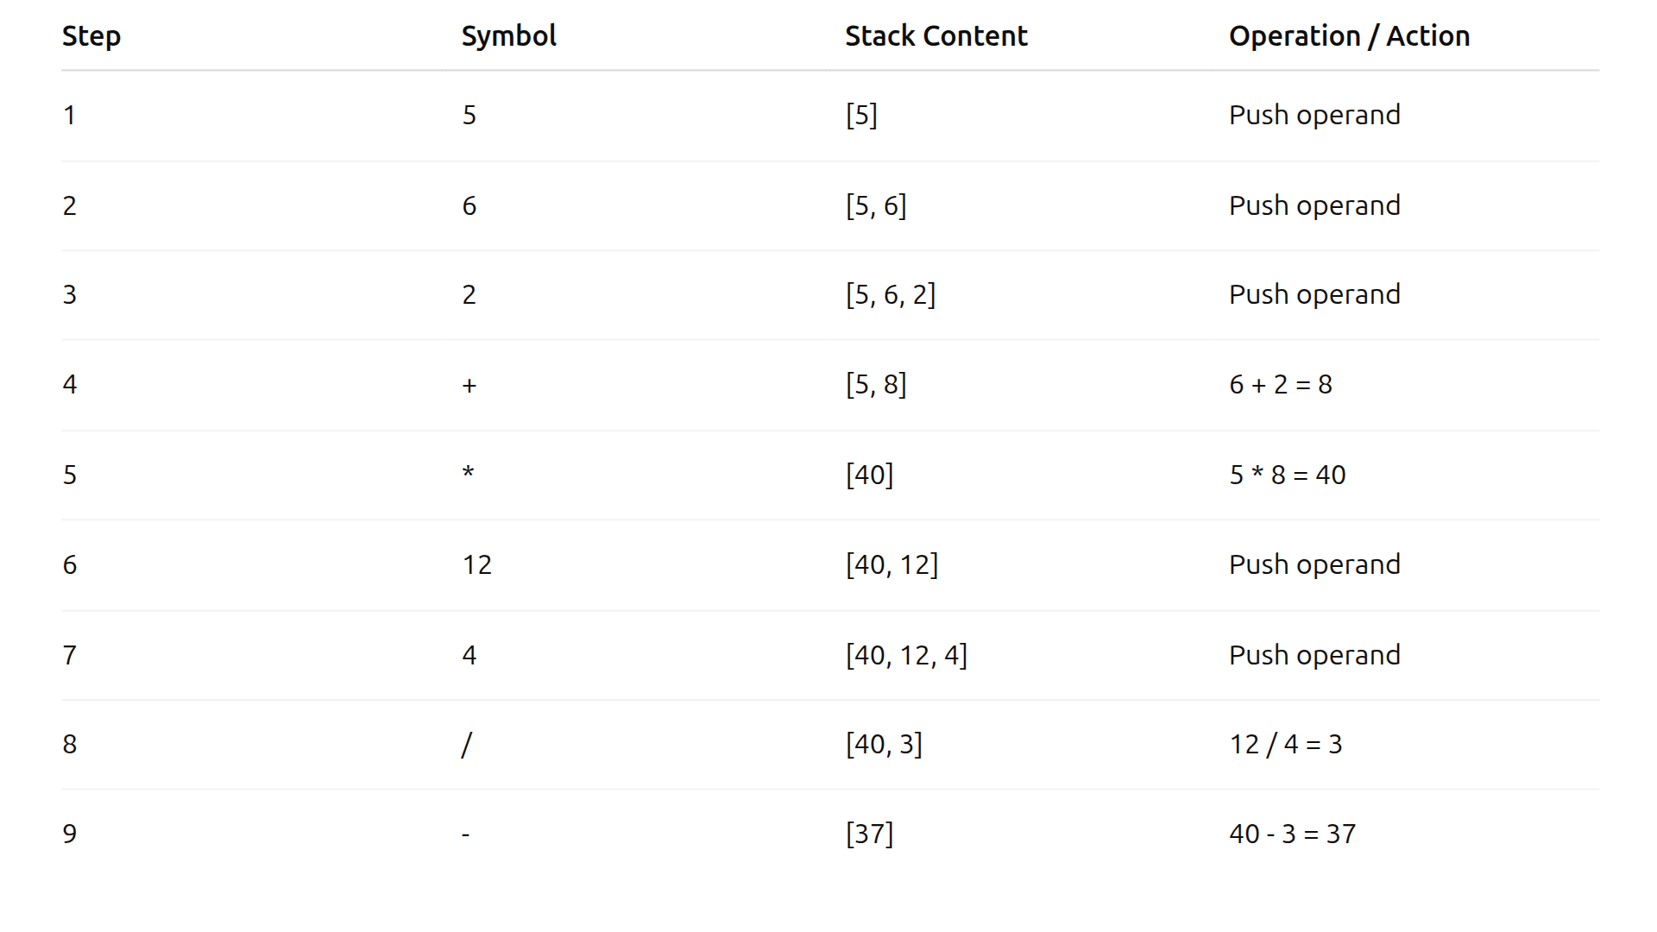
Example:
Let’s evaluate → 5 6 2 + * 12 4 / -
💡 Final Result : 37

Slide 7
Postfix Evaluation — Step-by-Step
Read the postfix expression left → right (tokens separated by spaces).
If token is an operand, push it onto the stack.
If token is an operator (+ - * /) :
4. Repeat until all tokens processed.
5. Final answer = single value remaining on stack (stack top).
6. Handle errors: if you try to pop when stack has <2 values → invalid
expression; after finish, if stack size ≠ 1 → invalid expression.
(Use integer division only if expression expects integers; otherwise handle floats.)
Pop the top value → b.
Pop the next top → a.
Compute result = a (op) b.
Push result back onto the stack.

Slide 8
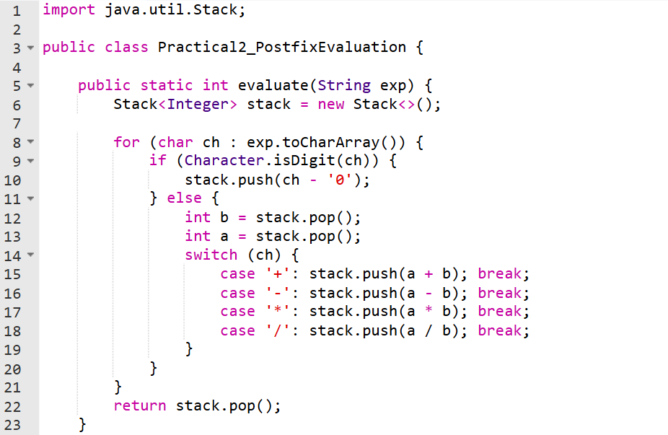
Code Implementation:

Slide 9
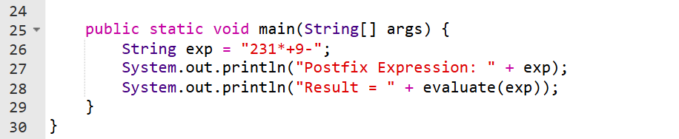

Slide 10
Output :
Postfix Expression: 231*+9-
Result = -4

Slide 11
Time & Space Complexity
Time Complexity: O(n)
Space Complexity: O(n)
Explanation:
Each element (operand or operator) is processed once.
Stack operations (push/pop) are constant time → overall linear complexity.

Slide 12
Summary
✅ These problems test real-world stack behavior in expression parsing and runtime tracking.
✅ Focus areas:
Operand/operator management
Parentheses handling
Operator precedence
Expression parsing logic

Slide 13
Real-World Applications:
Expression Evaluation in Compilers — parsing & executing code efficiently.
Scientific Calculators — internally use postfix evaluation.
Expression Converters — converting infix → postfix → evaluation.
Parsing and Syntax Checking — validating expressions in interpreters.

Slide 14
Practice Questions:
1. LeetCode 150 — Evaluate Reverse Polish Notation
🔗 https://leetcode.com/problems/evaluate-reverse-polish-notation/
Description: Given an array of strings tokens representing an expression in Reverse Polish Notation, evaluate the expression.
Valid operators: +, -, *, /.
Example Input: ["2","1","+","3","*"]
Output: 9
(Explanation: (2 + 1) * 3 = 9)

Slide 15
2. LeetCode 224 — Basic Calculator
🔗 https://leetcode.com/problems/basic-calculator/
Description: Implement a basic calculator to evaluate a simple expression string containing +, -, (, ), and spaces.
Use stack to handle parentheses and operator precedence.
Example Input: "(1+(4+5+2)-3)+(6+8)"
Output: 23

Slide 16
3. LeetCode 227 — Basic Calculator II
🔗 https://leetcode.com/problems/basic-calculator-ii/
Description: Evaluate a string expression containing non-negative integers and operators +, -, *, /.
No parentheses — but handle operator precedence correctly.
Example Input: "3+2*2"
Output: 7

Slide 17
4. LeetCode 227 — Basic Calculator III
🔗 https://leetcode.com/problems/basic-calculator-iii/
Description: Like Calculator II, but supports parentheses (, ) and must respect nested evaluation.
Use stack for both operands and operators.
Example Input: "2*(5+5*2)/3+(6/2+8)"
Output: 21

Slide 18
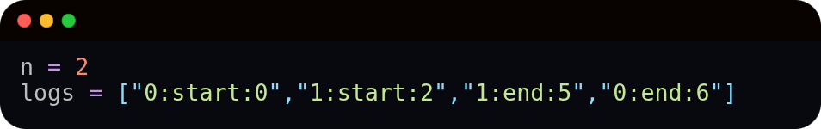
5. LeetCode 636 — Exclusive Time of Functions
🔗 https://leetcode.com/problems/exclusive-time-of-functions/
Description: You are given logs of function start and end times.
Use a stack to compute each function’s exclusive execution time.
Example Input:
Output: [3,4]

Slide 19
THANKS!

